Slide 1


Lecture 5:
K-NNs, Decision Trees, Ensemble Methods
McGill Artificial
Intelligence Society

Slide 2
Today’s Agenda
Review
K-Nearest Neighbours
Classification and Regression Trees (CART)
Ensemble Methods Introduction
Bagging (Bootstrap Aggregation)
Random forests
Boosting

Slide 3
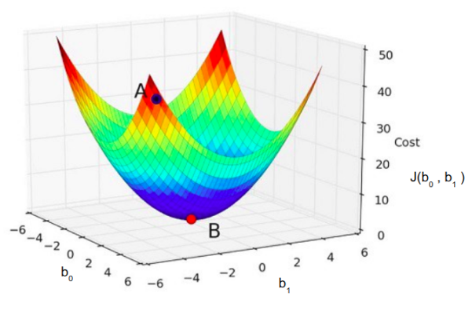
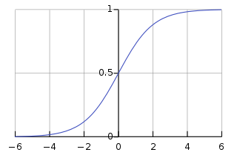
Review
Regression vs Classification
Continuous vs Discrete Outputs
Linear Regression
Least Mean Square Error (Derived from Residual Sum of Squares)
Gradient Descent
Logistic Regression
Classification based off of sigmoid function

Slide 4
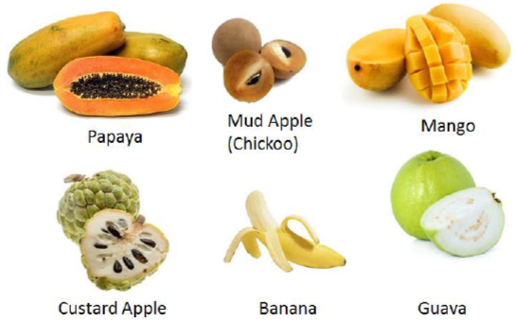


K-Nearest Neighbours
Supervised learning algorithm generally used for classification
Like other classification algorithms, estimates the conditional distribution of event x given y:
General Framework: classify observation to the class with the highest conditional probability
Notes:
Emphasize that this is just a general framework for classification, that behind the scenes for classification tasks the output for an algorithm are based off this expression, no matter how they internally compute that

Slide 5

K-Nearest Neighbours
Learning Algorithm Properties:
Non-parametric: does not assume underlying data distribution (e.g. linear regression assumes a Gaussian linear distribution, so each of its learned weights are what we call parameters)
E.g. → Θ is the parameter
Instance-based: the algorithm doesn’t explicitly learn a model. Instead, it memorizes training instances to use for the prediction phase, i.e. it learns a “database” that only returns a prediction when a test instance is passed to it

Slide 6
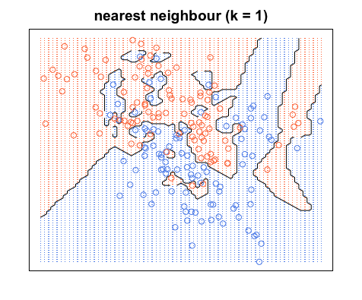
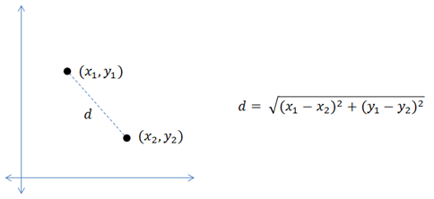
K-Nearest Neighbours
K-NN prediction is classified using a majority vote between the K closest instances (in the training set) to a given unseen (test) observation. Closeness is defined according to a distance metric between two data points, e.g. Euclidean distance, Hamming distance (depends on application).
Image Courtesy

Slide 7

The Algorithm
Breaking down the Equation:
LHS (left hand side) of Equation - Probability that your output Y is of class j given that your test input is x₀ (Conditional probability)
RHS of Equation - given K nearest neighbours in your dataset (we call that neighbourhood N₀ ), we sum up the neighbours of a particular class j: the indicator function I(x) evaluates to 1 when the equality is true, and 0 when it is false
Notes:
Ask class if they understand the notation after breaking down the equation, or there are any portions that are unclear
Emphasize that equations are being shown to expose students to mathematical notation, and if you’re learning anything serious in machine learning, it’s important to be familiar with reading and recognizing mathematical expressions. Many state-of-the-art breakthroughs are published as scientific papers

Slide 8
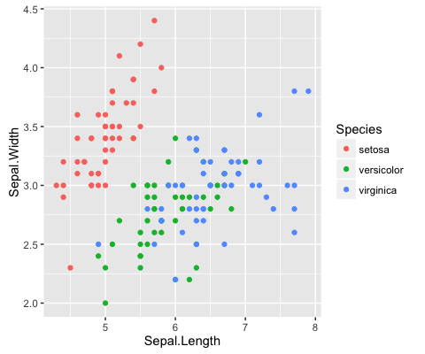
K-NN Demo on the Iris Dataset
Comparing classification algorithms
Image Courtesy
Notes:
Tutorial Demo Portion from: https://kevinzakka.github.io/2016/07/13/k-nearest-neighbor/#how-does-knn-work

Slide 9
K-NNs - Pros and Cons
Simple algorithm, easy to implement (good baseline)
No training time
Easily scalable to multiple classes
Works for “unusual” data distributions
Expensive query for test instances (time intensive)
Memory intensive: stores data instead of parameters
Not suitable for high-dimension data (curse of dimensionality)
Doesn’t work as well for skewed data distributions

Slide 10
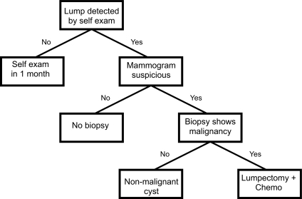
Classification and Regression Trees (CART)
AKA Decision Tree
Commonly known as decision trees, because data is partitioned within each node of a binary tree
Internal nodes are tests on the values of different features
The predictions/labels are found at the leaves of the tree
Cruz, Wishart, 2007
Notes:
We

Slide 11
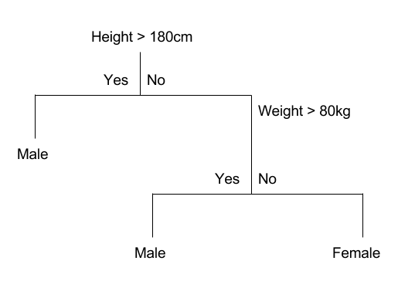
Example
2 input variables, 2 classes
From binary tree representation, predicting on a new test instance is straightforward:
Traverse the tree by evaluating the test instance starting from the root node
Image Courtesy

Slide 12
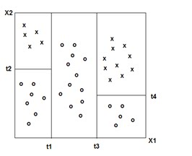
Geometric Interpretation - Partitioning the Feature Space
Each input feature in decision tree → dimension in feature space
Given a feature space, each test in your decision tree splits your data orthogonally (perpendicular) along the axis, creating a partition (region) of data.
NOTE: orthogonal splits extend to higher dimensions

Slide 13
Classification and Regression with Decision Trees
Regression: take the mean response within each of the regions to be the prediction/ label with respect to the items of those classes
Classification: most commonly occurring class of training
observations in the region to which it belongs
Notes:
Given this new geometric interpretation, one can guess the classification capabilities of decision trees: it works well on data distributions that can be orthogonally partitioned

Slide 14
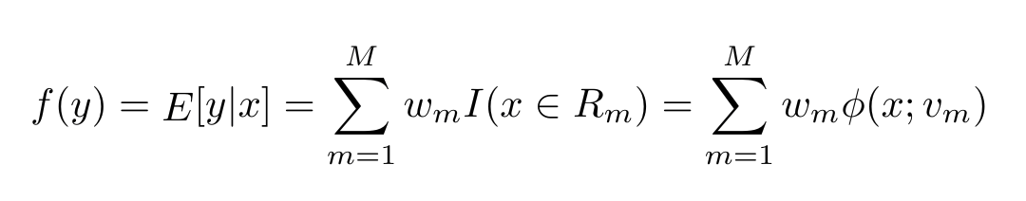
The Algorithm
R_{m} is the mth region
w_{m} is the mean response in this region (i.e. the label)
v_{m} encodevariable to split on, the ts the choice of hreshold value, and the path from the root to the mth leaf.
The difference between k-NN and decision tree classification lies in its prediction method: k-NN predicts the class with the highest conditional expectation, whereas decision trees compute the mean / expected response in a given region.

Slide 15
The Algorithm (Cont’d)
The difference between k-NN and decision tree classification lies in its prediction method: k-NN predicts the class with the highest conditional expectation, whereas decision trees compute the mean / expected response in a given region.
Where is the machine learning in this?...
The learning corresponds to pick the right tests, threshold values at each node in the tree, deciding the entire shape of the tree.
Generally follows a two step approach.

Slide 16
The Algorithm - Learning Decision Trees
Step 1
Grow the tree using a recursive top-down approach: start from the root node, grow the tree to leaf level
Step 2
Prune the learned tree to avoid overfitting - avoid having only very few instances per leaf
Notes:
Creating a binary decision tree is actually a process of dividing up the input space. (Read step 1)
Explain greedy split: We say recursive binary splitting is greedy because at each step of the tree-building process,
the best split is made at that particular step, rather than looking ahead and picking a split that will lead to a better tree in some future step. Optimal partitioning is very computationally expensive, so we tend to use greedy algorithms

Slide 17
The Algorithm - Learning Decision Trees
Step 1 - Grow the tree recursively using binary splits
All input variables and all possible split points are evaluated and chosen in a greedy manner (e.g. the very best split point is chosen each time).
For every feature, all the values are lined up (sorted) and different split points are tried and tested using a cost function.
Select the split with the lowest cost
Notes:
Explain greedy split: We say recursive binary splitting is greedy because at each step of the tree-building process,
the best split is made at that particular step, rather than looking ahead and picking a split that will lead to a better tree in some future step. Optimal partitioning is very computationally expensive, so we tend to use greedy algorithms

Slide 18
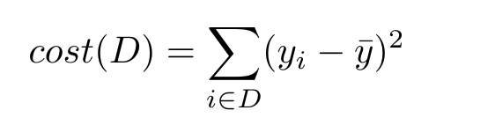
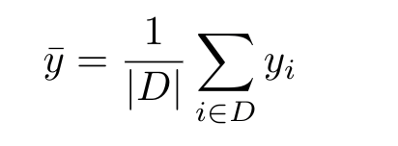
Regression Costs
In regression, we define the cost (to minimize) as:
Where y-bar is the unbiased sample average of the dataset in a region:
Notes:
Regression cost is pretty chill, just least squares, usually jig

Slide 19
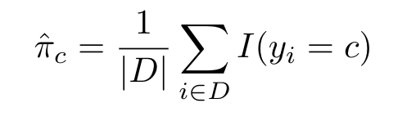
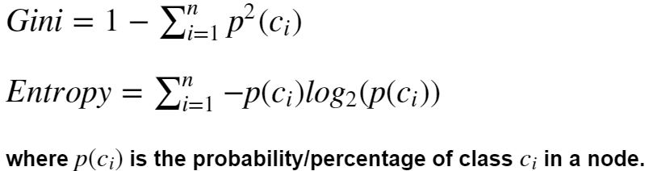
Classification Costs
In classification, there are multiple cost functions we can use. However, as a whole, we are looking to maximizing classification accuracy:
Given this problem definition, there are multiple ways in which we can define the cost function in order to solve this problem
Misclassification Rate
Gini Index
Entropy (disorder)
Gini index and entropy are similar (even performance-wise), both measure the impurity of a node (the ones with many classes)
High entropy → disorder
Notes:
Both gini and entropy are measures of impurity of a node. A node having multiple classes is impure whereas a node having only one class is pure.
Want to minimize entropy,
Just classification accuracy, don’t really know what more to say. Gini Index and Cross Entropy are actually remarkably similar, so maybe we can mention that. It’s also notable that both will tend towards a pure node if reduction in cost is equal between two options of classification

Slide 20
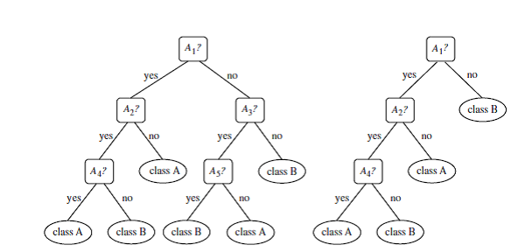
The Algorithm - Learning Decision Trees
Step 2 - Pruning the Tree
Problem - when trying to maximize purity at leaf nodes, decision trees tend to overfit
Pruning: Removing the branches with unimportant features. The goal is to reduce overfitting by decreasing variance, at the cost of a bit of bias (e.g., can specify hyperparameter for max tree depth)

Slide 21
What types of functions can decision trees learn?
In general, decision trees are suitable for problems where the class label is the same in large partitions that can be “cut out” using only axis-perpendicular cuts
Can create poorly performing trees if there is a huge class imbalance, good idea to inspect dataset and balance it before training
Greedy algorithms do not guarantee globally optimal decision tree… what can we do?
→ Train multiple trees, where the features and samples are randomly sampled with replacement.
Multiple learners?

Slide 22
Ensemble Methods
Take many models to create a strong learner!
Bagging
Averaging Unstable Learners
Reducing Variance
Random Forests
Dropouts in neural networks
Boosting
Stacking Weak Learners
Reducing Bias
AdaBoost
Gradient Boosting
Notes:
Note reducing variance in bagging tends to increase bias a little
Unstable learners are learning algorithms with higher variance (sensitive to noisy inputs), e.g. decision trees, kNN, neural networks

Slide 23
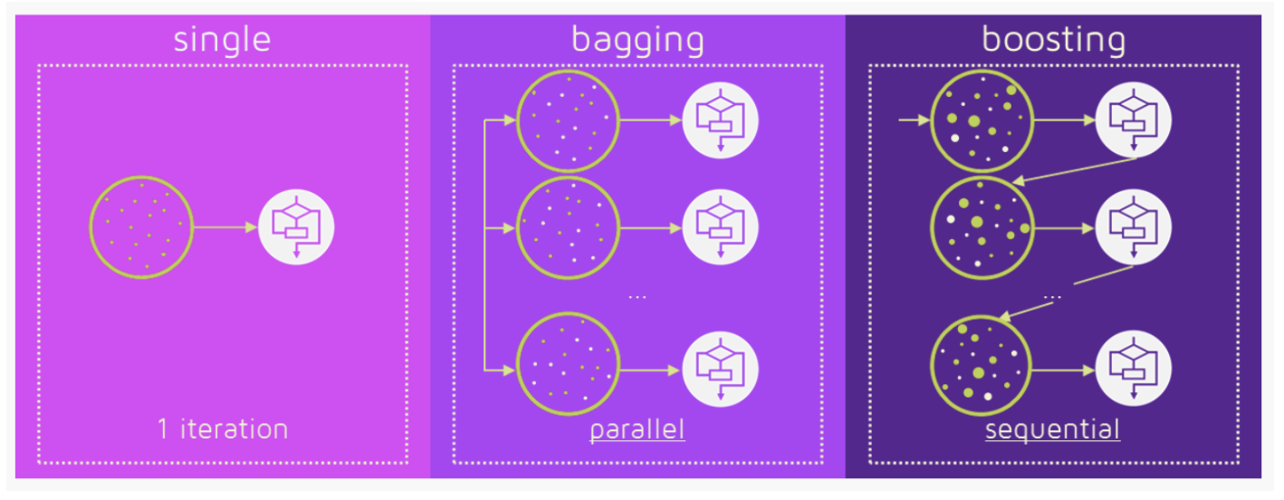
How They Work?

Slide 24
Bootstrap Aggregation (Bagging)
Bootstrapping: from original dataset D with k samples, sample k samples at random with resampling to form set D_{k} - then test on remaining samples T_{k} = D - D_{k}
Develop n different models for the n-different samples, and train them only on those respective samples
With each test set point, run all n models on the test set point, average/vote on the label (Depends on classification or regression problem)
:
Notes:
We show an example from this in the next several slides.

Slide 25
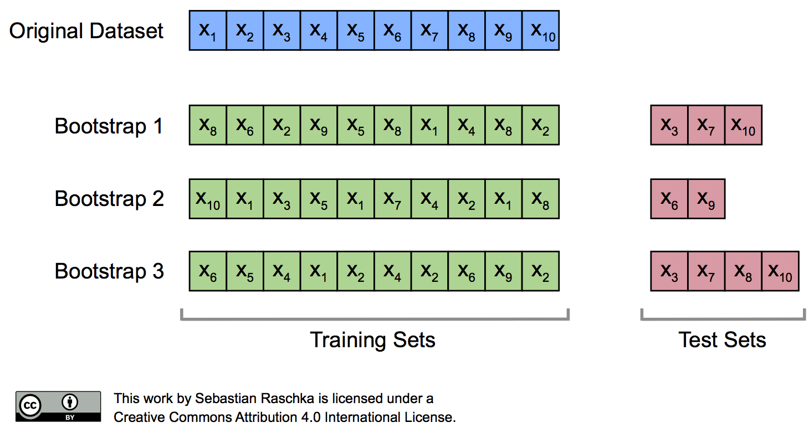
Bootstrap Aggregation (Bagging)
:
Notes:
Note: repeat this process k times, value of k can range in the hundreds typically for large datasets
Every learner learns slightly different distributions of the dataset, decreases variance when you train many learners

Slide 26

Example - Random Forests
Image Courtesy

Slide 27
Example - Random Forests
Majority vote for predicting discrete outputs (classification)
Take mean hypothesis for regression tasks
Better performance in general, lower variance
Run in parallel
Lose interpretability decision trees have
Larger memory requirements to store model

Slide 28
Boosting
4 Steps
We first take a (group of) weak learner and identify the samples that are difficult to understand by training it and “testing” it
Each base classifier is trained on data that is weighted
based on the performance of the previous classifier
Assign higher weights to the harder samples so that the learners focus on learning those samples
???
Profit
NOTE: Unlike bagging, where individual learners learn independently, boosting involves weak learners that depend heavily on the previous learners.
:
Notes:
We show an example from this in the next several slides.

Slide 29
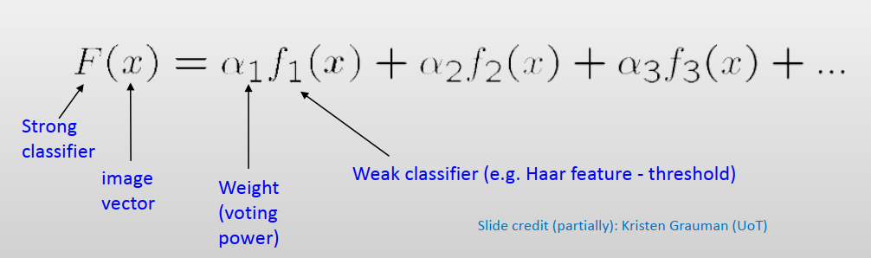
Boosting
:
Notes:
We show an example from this in the next several slides.

Slide 30
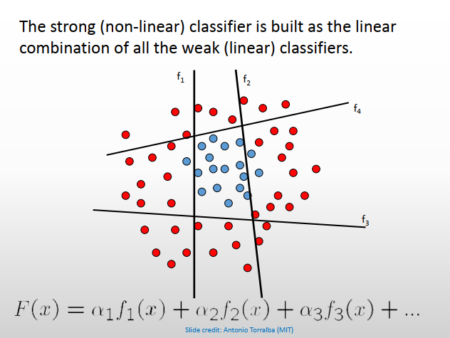
Boosting
:
Notes:
We show an example from this in the next several slides.

Slide 31
Homework Assignment
Algorithm Comparison and Exploration
Assignment5-AlgorithmComparsion.ipynb
Notes:
https://www.w3resource.com/python-exercises/numpy/linear-algebra/numpy-linear-algebra-exercise-1.php
Read up on eigenvectors and eigenvalues

Slide 32
Thanks!
Any questions?
McGill Artificial
Intelligence Society

